Slide 1
Multicurrency
29 August 2011
Notes:
Multicurrency - <number>
Guidewire training materials contain Guidewire proprietary information that is subject to confidentiality and non-disclosure agreements. You agree to use the information in this manual solely for the purpose of training to implement Guidewire software solutions. You also agree not to disclose the information in this manual to third parties or copy this manual without prior written consent from Guidewire. Guidewire training may be given only by Guidewire employees or certified Guidewire partners under the appropriate agreement with Guidewire.

Slide 2
Lesson objectives
By the end of this lesson, you should be able to:
  Describe how multicurrency functionality appears to and is used by end users
  Describe the technical architecture that enables multicurrency
  Implement multicurrency
  This lesson uses the notes section for additional explanation and information.
  To view the notes in PowerPoint, choose View→Normal or View→Notes Page.
  If you choose to print the notes for the lesson, be sure to select “Print hidden slides.”
Notes:
Multicurrency - <number>

Slide 3
Lesson outline
Business overview of multicurrency
Technical overview of multicurrency
Configuring multicurrency
Notes:
Multicurrency - <number>

Slide 4
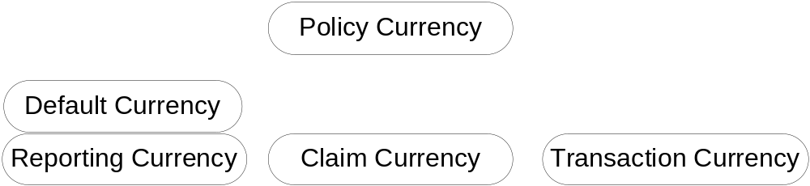
Currency terminology
Default currency is the "base currency" for a given instance of ClaimCenter.
  Typically the currency in which carrier maintains its company-wide financials
  All currency conversions are either to or from this currency
Reporting currency is the currency in which reports are created within ClaimCenter.
  Reporting currency is currently equivalent to default currency
Notes:
Multicurrency - <number>
Default currency is defined at server startup

Slide 5
Currency terminology (2)
Policy currency is the currency associated with a given policy.
  Set within the policy search adapter
  Changes to policy currency always propagate to the claim currency
Claim currency is the currency associated with a given claim.
  Always locked to the policy currency
  Financials summary information is always displayed in the claim currency
Transaction currency is the currency used by a given transaction.
Notes:
Multicurrency - <number>
If the claim currency is not editable (which can occur if the claim has existing transactions), then the policy currency can not be updated.
The set of possible currencies for given transaction is defined in the Currency typelist.

Slide 6
Multicurrency scenarios
Cross-border claims
Multi-national carriers

Slide 7
Cross-border claims
Insured lives in London , UK and has accident in Calais, France
Jean-Paul's Garage
bill: €417
Dr. Gareth Baker
bill: £283
Multicurrency is a feature which lets ClaimCenter execute financial transactions in more than one currency
  Primarily of interest to customers who have reasonable volume of business in two or more currencies
Notes:
Multicurrency - <number>
The ClaimCenter multicurrency feature lets you create financial transactions in more than one currency. It knows the base ClaimCenter currency (referred to as the "default currency"), but accounts for these transactions in the currencies in which they were made. Finally, it adjusts for exchange rate fluctuations that change payment (but not recovery) amounts.
Every instance of ClaimCenter uses a single default currency, but many tasks can now be performed using another transaction currency. In particular, a ClaimCenter user may:
Create payments, issue checks, and receive recoveries in any currency.
Create reserves and recovery reserves in any currency; all of them, no matter their currency, still contribute to the aggregate reserves and recovery reserves, which are always displayed in units of the default currency.
Search for checks and recoveries in any particular currency - or in all currencies.
Create bulk invoice payments and write their associated checks in any currency.
View financial summaries which include all transactions, independent of their currency. (Financial summaries are always displayed in the claim currency.)
Adjust the actual amount, in the default currency, of a check and its payment(s), after the check has been cashed and the actual amount of the check in the default currency (which has changed because of exchange rate fluctuations) is known.
Add a Preferred Currency field to contacts, which tells ClaimCenter the default currency to use when writing a check to that contact (vendor).
Enter exchange rates manually when needed, or automatically get them from an outside provider.
Periodically update exchange rates obtained from an outside provider.

Slide 8
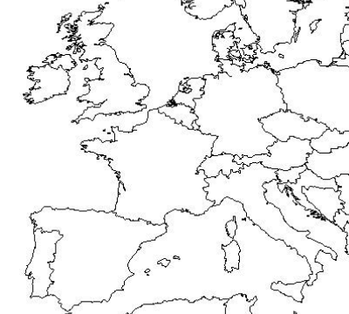
Multi-national carriers
Stuart Smythe (£)
Philippe Mamet (€)
Policy-based multicurrency is a feature which lets ClaimCenter handle claims for policies written in different currencies
  Primarily of interest to carriers who underwrite policies in two or more currencies
Notes:
Multicurrency - <number>

Slide 9
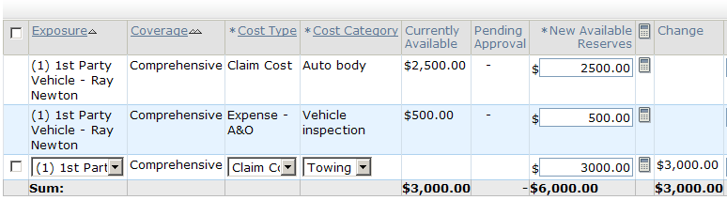
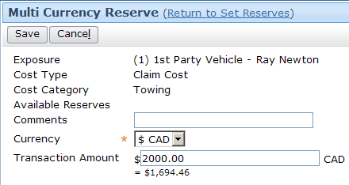
Create reserve transactions in other currency
By default, reserves are created in claim currency
  However, users can select other currency for reserve
Notes:
Multicurrency - <number>

Slide 10
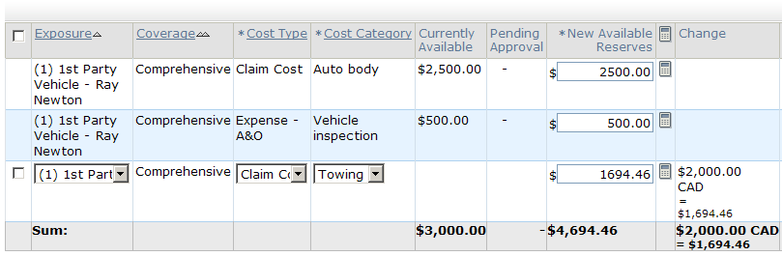
Display reserve transactions in other currency
If reserve transaction is in non-claim currency, then amount is displayed in both transaction currency and claim currency
Notes:
Multicurrency - <number>
If you make multiple reserve edits in multiple currencies at the same time, then only the default currency will be displayed on this screen, although each of the currencies will be displayed for each individual transaction on the Transactions screen.

Slide 11
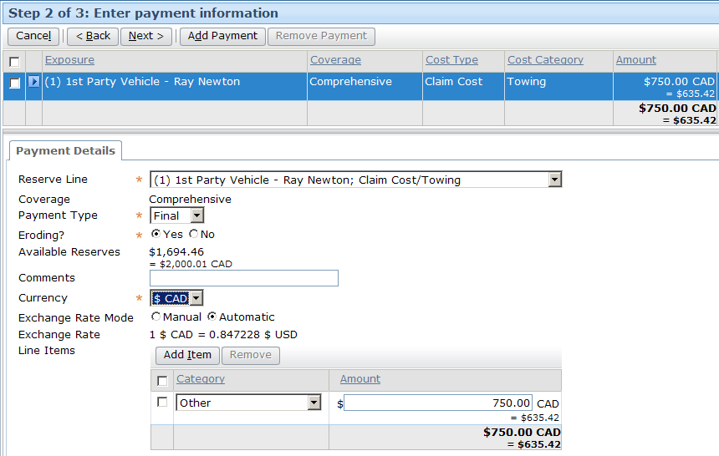
Multicurrency and payments
Payments can be done in claim or other currency
Notes:
Multicurrency - <number>

Slide 12
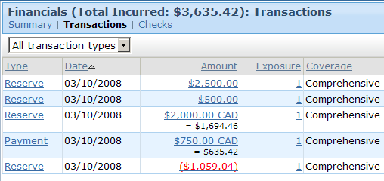
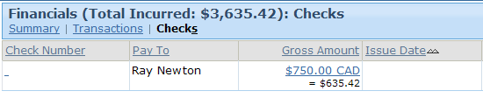
Transactions and checks
Transactions and checks in non-claim currency are displayed in both the transaction/check amount and claim currency amount
Notes:
Multicurrency - <number>

Slide 13
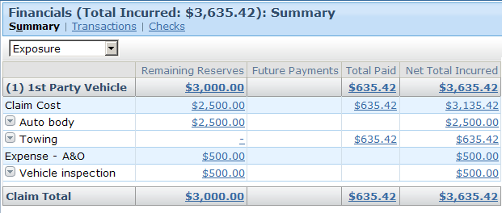
Financial summary only in claim currency
Summary information is displayed only in claim currency
  This is because each value could be result of multiple transactions across multiple currencies
Notes:
Multicurrency - <number>

Slide 14
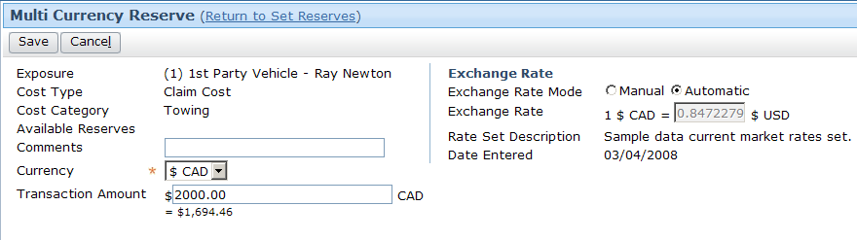
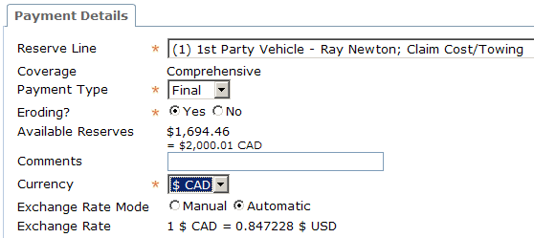
Exchange rate modes
End users can use "automatic" exchange rate or enter custom rate manually
Notes:
Multicurrency - <number>

Slide 15
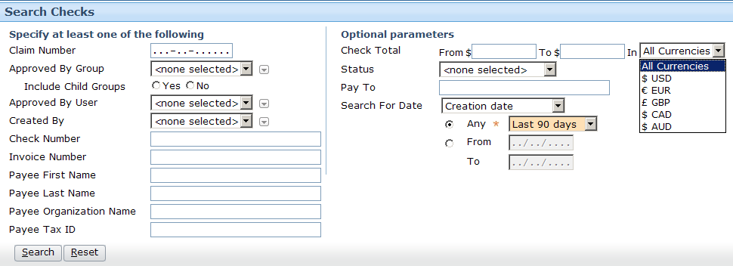
Multicurrency and searches
Currency is available as search criteria
  This applies to checks, recoveries, and bulk invoices
Notes:
Multicurrency - <number>
Note that this searches for explicit field values, not converted values. For example, searching for a $1 USD check will only find checks for $1 USD, not checks in other currencies that are equal to $1 USD.

Slide 16
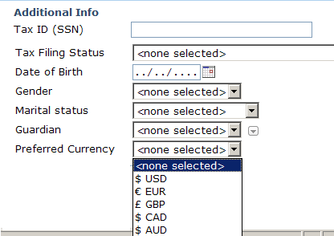
Contact preferred currency
Contacts can have preferred currency
  Payments to that contact default to that currency
Notes:
Multicurrency - <number>
This is typically used from the Parties Involved screen.

Slide 17
Lesson outline
Business overview of multicurrency
Technical overview of multicurrency
Configuring multicurrency
Notes:
Multicurrency - <number>

Slide 18
Architecting multicurrency
In order to implement multicurrency, ClaimCenter needs:
  List of supported currencies
  Ability to track the currency of each transaction
  Ability to convert amount from one transaction to another
    This conversion always involves the default currency
  Ability to obtain and update exchange rates
Notes:
Multicurrency - <number>

Slide 19
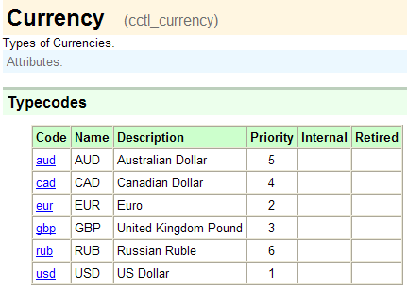
The Currency typelist
Currency typelist identifies currencies in which transactions can be recorded
Notes:
Multicurrency - <number>

Slide 20
Transactional currency handling
transactionLineItem.ReportingAmount
transactionLineItem.ClaimAmount
transactionLineItem.TransactionAmount
Notes:
Multicurrency - <number>
The TransactionLineItem entity has three fields representing the amount of the transaction: ReportingAmount, ClaimAmount, and TransactionAmount. The values in these fields are all based on the same amount, but they are in the reporting currency, claim currency, and transaction currency, respectively.

Slide 21

Transactional currency handling example
Incident/Exposure:
Collision in Denmark
(DKK)
Carrier:
ACME Insurance (£)
Insured:
Philippe Mamet (€)
Carrier located in UK (default/reporting currency is £)
Insured lives in France (claim/policy currency is €)
Incident occurs in Denmark (transaction currency is DKK)
Notes:
Multicurrency - <number>
DKK = Danish Kroner

Slide 22
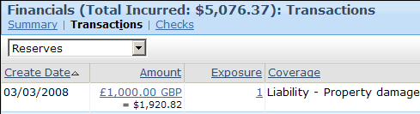
Multicurrency fields in the transaction entity
Currency - currency of the transaction
(shown above as GBP - Great Britain pounds)
TransactionAmount - amount, or "face value", of transaction
(shown above as 1000.00)
ClaimAmount - TransactionAmount converted to claim currency
(shown above as 1920.82, in the claim currency US $)
TransToClaimExchangeRate - the conversion factor between TransactionAmount and ClaimAmount
(not shown, but equal to 1.92082)
Notes:
Multicurrency - <number>
There is also a ReportingAmount field, which is the TransactionAmount converted to reporting currency, which is used for all ClaimCenter reporting.
Bulk Invoices may now be written in any single currency, not just the default currency.

Slide 23
The ExchangeRate entity
£
€
1.301
An ExchangeRate is an object used to convert an amount from one currency to another
  Single ExchangeRate object supports conversion in one direction only
Key fields
  BaseCurrency ("from" currency, as in GB pounds)
  PriceCurrency ("to" currency, as in Euro)
  Rate (the conversion multiplier, as in 1.301)
Notes:
Multicurrency - <number>

Slide 24
The ExchangeRateSet entity
£
Effective: 01/06/2008
£
£
€
Expiration: 31/08/2008
1.000
1.301
€
£
€
€
0.764
1.000
An ExchangeRateSet is a collection of exchange rates
  Includes set of exchange rates
    Number is typically x² where x is number of currencies, which allows conversion between any pair of currencies
  Includes effective and expiration date
Notes:
Multicurrency - <number>
ExchangeRateSets will only have a single ExchangeRate when the user creates an exchange rate manually.

Slide 25



Exchange rate sets in each mode
Automatic Mode
£
£
£
€
Exchange
Rate
Application
1.000
1.301
€
£
€
€
0.764
1.000
June 1, 2008 to June 7, 2008
Manual Mode
£
€
1.250
Andy Applegate
NULL to NULL
Notes:
Multicurrency - <number>
In most cases, exchange rates are retrieved (via batch jobs) by ClaimCenter from a third-party source. These exchange rates are typically stored in ClaimCenter with an effective and expiration date. When a user creates a transaction in automatic mode, the appropriate exchange rate from this type of set is used.
When a user creates a transaction with a custom exchange rate that he enters using manual mode, then an exchange rate set is created with a single exchange rate. This exchange rate set has no effective and expiration date because it is valid only for that transaction, so the date fields are set to NULL.

Slide 26
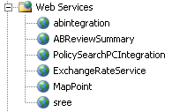
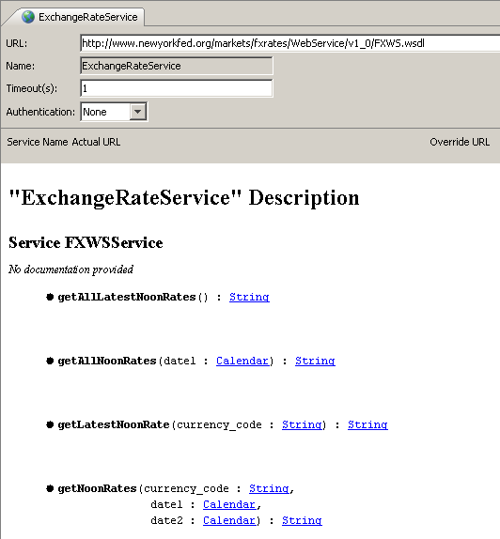
Obtaining exchange rates
Exchange rates can enter into ClaimCenter through:
  An ER (Exchange Rate) plug-in tied to an internal or third-party system
  A batch process
Notes:
Multicurrency - <number>
ClaimCenter typically obtains current, market-based exchange rates from a web service to an external third-party system. The sample provided in the base application retrieves data from the Federal Reserve Bank of New York (http://www.newyorkfed.org/xml/fx.html).

Slide 27
Adjusting amount to rectify fluctuating exchange rates
Exchange rates can fluctuate between the time a check is written and the time it is cashed
ClaimCenter needs to record the actual amount paid in claim and default currencies
  Function calls are provided in IClaimFinancialsAPI
These adjustments should only be executed when the transactions are in certain statuses
Notes:
Multicurrency - <number>
ClaimCenter records the ClaimAmount and ReportingAmount at the time that checks are created, using the current exchange rates. There is often a lag between the time a check is written and the time it is cashed. It is possible that the real world exchange rates have changed in that intervening time. ClaimCenter needs to be updated to record the actual ClaimAmount and ReportingAmount that the check represented at the time it was cashed.
Adjustments may only be made when the entity has certain transaction statuses:
A check must have a status of requesting, requested, recoded, transferred, issued or cleared, but not denied, voided or stopped.
A payment must be submitting or submitted, but not rejected or denied.
You may make exchange rate adjustments on a single payment, or on a check amount and all of its payments (excluding recoded, cancelled or offset payments) at once.

Slide 28
Lesson outline
Business overview of multicurrency
Technical overview of multicurrency
Configuring multicurrency
Notes:
Multicurrency - <number>

Slide 29
Overview of multicurrency configuration
To implement multicurrency, you must:
  Set application parameters which:
    Enable multicurrency
    Identify the default currency
  For each currency to be used:
    Add the currency to the Currency typelist
    Specify display format information
    Read in exchange rates for the currency
Notes:
Multicurrency - <number>

Slide 30
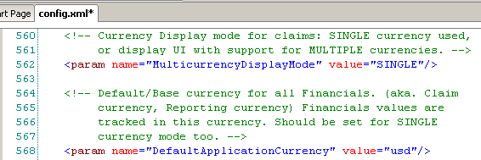

Configuration parameters
Set to "MULTIPLE"
Set to desired default currency
Notes:
Multicurrency - <number>

Slide 31
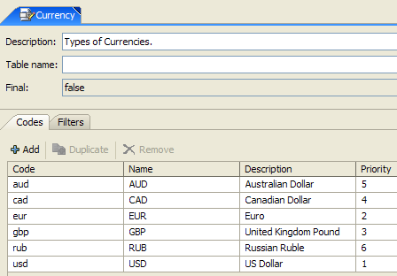
Add currency to Currency typelist
Base application contains six currencies
  Add additional currencies as needed
Notes:
Multicurrency - <number>

Slide 32
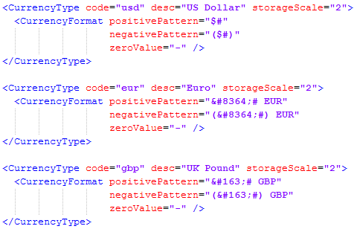
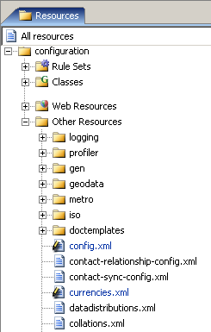
Specify currency format
You must restart ClaimCenter to deploy changes to currencies.xml
Notes:
Multicurrency - <number>
currencies.xml defines information about each currency.
The CurrencyFormat tag controls how each currency is displayed. You must have a CurrencyFormat tag for each currency.
The positivePattern and negativePattern attributes define how ClaimCenter displays positive and negative currency values. The character # (pound sign) is replaced with the actual number, and all other characters in the pattern are displayed literally. For example, the positivePattern $# displays the value 32 as $32, and the negativePattern ($#) displays the value -5 as ($5). The pattern can include more than one character, such as #USD to display as 5USD.
The zeroValue attribute defines how ClaimCenter displays zero or null values. For example, this could be 0 (zero) or — (dash).
Currency characters should be defined using their Unicode characters, with HTML Entity (decimal) encoding. (A Google search for "unicode yen symbol", for example, comes up with the proper code for the yen.)

Slide 33
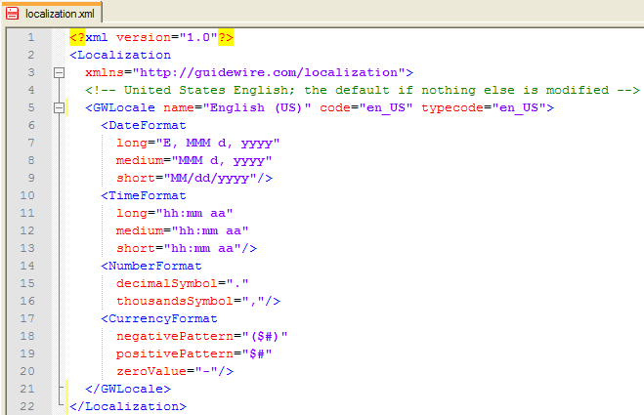

The localization.xml file
This currency format is used only when ClaimCenter is in single-currency mode
  The CurrencyFormat tag is still required for the default locale's currency for multicurrency configurations
Notes:
Multicurrency - <number>
The <CurencyFormat> tag in localization.xml is only used in single mode, but a tag for the default locale's currency must be present in this file even when in multiple mode.

Slide 34
Lesson objectives
You should now be able to:
  Describe how multicurrency functionality appears to and is used by end users
  Describe the technical architecture that enables multicurrency
  Implement multicurrency
Notes:
Multicurrency - <number>

Slide 35
Review questions
Which of the three Financials screens (Summary, Transactions, Checks) always displays information in only the claim currency? Why?
Where does ClaimCenter store information about the date range in which a given exchange rate is valid?
If ClaimCenter acquires exchange rate information about four currencies in a single exchange rate set, how many exchange rates will be in that set?
What is the difference between the "automatic" and "manual" modes of an exchange rate?
How does ClaimCenter know which currency is the default currency?
Notes:
Multicurrency - <number>
Answers
1. The Summary screen. This is because each reserve line could be the result of transactions in multiple currencies.
2. It stores it in the ExchangeRateSet object containing the exchange rates.
3. 16. (The number is always the square of the number of currencies.)
4. An automatic mode exchange rate is read from a third-party source and has an effective and expiration date. A manual mode exchange rate is entered manually by the user and is applicable only to that transaction.
5. The default currency is specified in config.xml in the DefaultApplicationCurrency parameter.

Slide 36
Notices
Copyright © 2001-2011 Guidewire Software, Inc. All Rights Reserved.
Guidewire, Guidewire Software, Guidewire ClaimCenter, Guidewire PolicyCenter, Guidewire BillingCenter, Guidewire Reinsurance Management, Guidewire ContactManager, Guidewire Vendor Data Management, Guidewire Client Data Management, Guidewire InsuranceSuite, Guidewire ContactCenter, Guidewire Studio, Gosu, Deliver Insurance Your Way, and the Guidewire logo are trademarks or registered trademarks of Guidewire Software, Inc. in the United States and/or other countries.
This material is Guidewire proprietary and confidential. The contents of this material, including product architecture details and APIs, are considered confidential and are fully protected by customer licensing confidentiality agreements and signed Non-Disclosure Agreements (NDAs).
This file and the contents herein are the property of Guidewire Software, Inc. Use of this course material is restricted to students officially registered in this specific Guidewire-instructed course, or for other use expressly authorized by Guidewire. Replication or distribution of this course material in electronic, paper, or other format is prohibited without express permission from Guidewire.
    Guidewire products are protected by one or more of the following patents: U.S. Patent No. 7,885,831; U.S. Patent No. 7,788,296.
Notes:
Introduction to Guidewire Configuration - <number>

